Slide 1


CSB4301 – Theory of Computation
B.Tech – Vth Semester
DFA to RE State Reduction
Mr. D.S.John Deva Prasanna AP(SG)
Department of Computer Science and Engineering

Slide 2
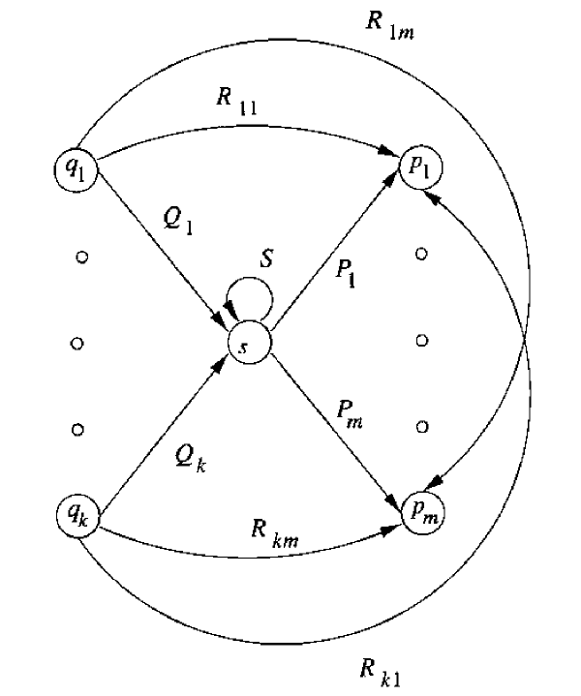
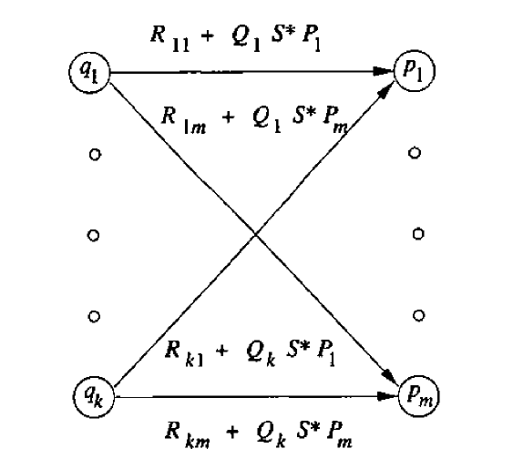
Obtaining RE from DFA by removing States

Slide 3
DFA – After Reduced State

Slide 4
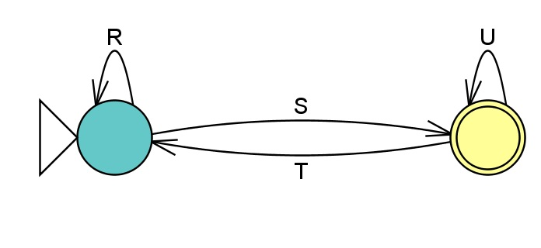
Strategy of obtaining RE from DFA by removing states
For each accepting state q in a DFA reduce the states as shown in the example. Write the combined RE obtained on the edges. Eliminate all states except ‘q’ and the start state.
If we will be left with two states that look like
The generic RE of the above DFA R*+(SU*T)*SU*

Slide 5
How do we get R*+(SU*T)*SU*
We go from start state to itself by following the sequence L(R) or L(SU*T).
Then we can move from the start state to the accepting state by following L(S) and loop around in the accepting state with L(U).

Slide 6
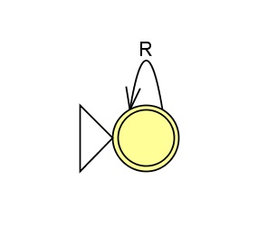
Strategy of obtaining RE from DFA by removing states
If the start state is also accepting state then we reduce all states except the state which is both start state and accepting state. In this case we get
The resultant RE is the sum (union) of all RE obtained by the above rules.

Slide 7
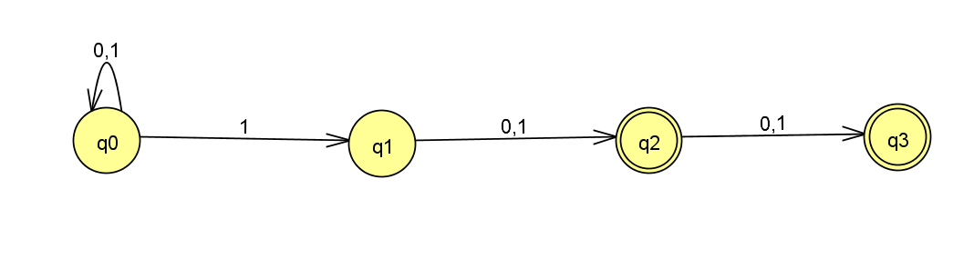
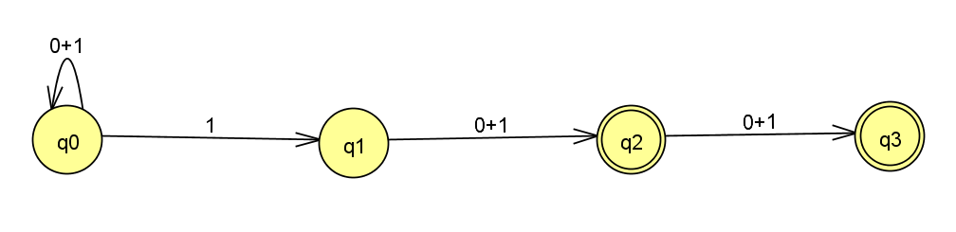
Strategy of obtaining RE from DFA by removing states
We try to obtain RE from the given NFA

Slide 8
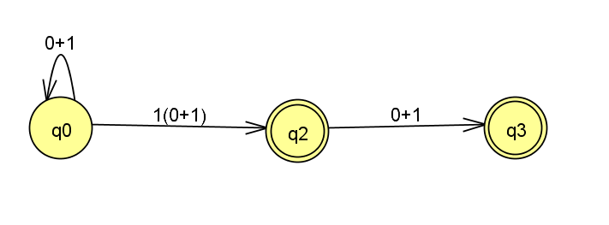
Strategy of obtaining RE from DFA by removing states
After eliminating state q1.
Note here we have two accepting states,
For strings which will be accepted by the state q2 we shall remove q3.
For strings which will be accepted by the state q3 we shall remove q2.

Slide 9
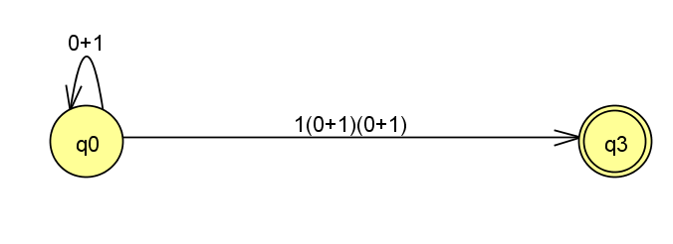
Strategy of obtaining RE from DFA by removing states
After eliminating state q2 we get
The above NFA will give the RE of strings accepted by q3.
The resultant RE is (0+1)*1(0+1)(0+1) ----------------------(1)

Slide 10
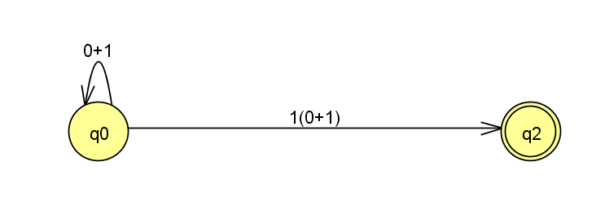
Strategy of obtaining RE from DFA by removing states
By eliminating state q3 we get
For strings which will be accepted by the state q2 we shall remove q3.
The resultant RE is (0+1)*1(0+1) ------------------(2)
Therefore the over all RE is (0+1)*1(0+1) + (0+1)*1(0+1)(0+1)

